Slide 1
Support Vector Machine
Parinya Sanguansat

Slide 2
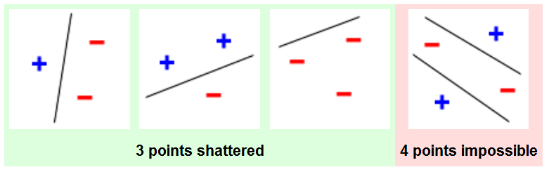
VC dimension
VC dimension of a model f is h' where h' is the maximum h such that some data point set of cardinality h can be shattered by f. (binary)
It can predict a probabilistic upper bound on the test error of a classification model.
VC dimension of Straight line = 3
VC dimension of Rectangle = ?
What has the highest VC dimension?
Notes:
4
Lookup table

Slide 3
Hyperplane
In 1-D space, we use dot to classify the features
In 2-D space, we use line to classify the features
Class 1
Class 2
x₂
x₁

Slide 4
Hyperplane
In 2-D space, we use line to classify the features
In n-D space, we use hyperplane

Slide 5
Linear Classifier
Recall the perceptron
  Depend on initialization
x₂
x₁

Slide 6
Which hyperplane is the best?
What is the criterion?
x₂
x₁

Slide 7
Misclassification
Best = Most generalization
x₂
x₁

Slide 8
Canonical hyperplanes
Maximal margin
x₂
Support Vector Machine
Support Vectors
x₁

Slide 9
Margin
Margin is the shortest distance between lines
x₂
x₁

Slide 10
Binary Classification
Two classes, 1 and -1
x₂
x₁

Slide 11
Linear SVM
Maximize the margin over the training samples
Or minimize this criterion

Slide 12
Quadratic Programming
General form
No close-form solution!
Many iterative methods are available
  Interior-point
  Active-set
  Trust-region-reflective

Slide 13
SVM with MATLAB
Solve via quadprog

Slide 14
Generalized Lagrangian
Generalize for both inequality and equality constraints by Karush-Kuhn-Tucker (KKT) condition

Slide 15
Optimization
Differentiating
Substituting into the Lagrangian

Slide 16
Quadratic Optimization Problem
Dual problem → Quadratic problem
The solution:

Slide 17
QP of dual problem with MATLAB
Solve via quadprog

Slide 18
Support Vector Machines?
Only SVs are kept
x₂
Support Vector Machine
Support Vectors
x₁

Slide 19
Soft Margin
x₂
Noisy data
x₁

Slide 20
Soft Margin Classification
Training error
Hard Margin
C is the tradeoff parameter
  Can be viewed as a way to control over-fitting.

Slide 21
Primal: Soft Margin
OP
Lagrange multipliers with KKT

Slide 22
Dual: Soft Margin
Differentiating
Substituting into the Lagrangian
Same as hard margin!!! ???

Slide 23
Quadratic Optimization Problem
Dual problem → Quadratic problem
The solution:

Slide 24
QP of Soft Margin with MATLAB
Solve via quadprog

Slide 25
Nonlinear space
We cannot use a line (linear) to classify them
Some curve (nonlinear) can do it

Slide 26
Classification in nonlinear space
All we learned is how to classify in linear space
  How to deal with nonlinear space?
2 steps approach
  Transform to linear space
  Perform linear classifier
1 step approach
  Kernel machine

Slide 27
Nonlinear to linear transformation
Same dimension
  #attribute = #feature

Slide 28
VC Dimension
x₂
x₂
x₂
x₂
x₁
x₁
x₁
x₁
x₂
x₂
x₂
x₂
x₁
x₁
x₁
x₁

Slide 29
VC Dimension
x₂
x₁

Slide 30
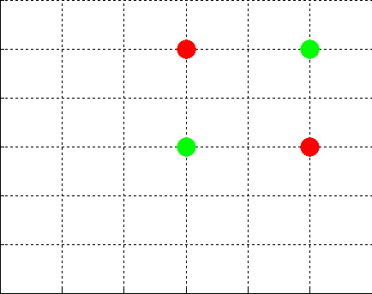
Higher dimension transformation
Ex: 2D → 3D transformation

Slide 31
Kernel trick
Mercer's theorem
  Any continuous, symmetric, positive semi-definite kernel function can be expressed as a dot product in a high-dimensional space.
  Inner product is only scalar
Kernel trick
  Wherever a dot product is used, it is replaced with the kernel function.
    is the mapping function from lower dimensional nonlinear space to higher dimensional linear space

Slide 32
Common kernel functions
Linear
Polynomial
Radial Basis Function (RBF)
Gaussian RBF
Sigmoid

Slide 33
MATLAB implementation for RBF kernel
From
Thus
XX = ones(size(Y,2),1)*sum(X.^2,1);
YY = ones(N,1)* sum(Y.^2,1);
K = XX+YY' - 2*Y'*X;

Slide 34
Non-linear SVM
Dual problem → Quadratic problem
The solution:
  where chosen so that

Slide 35
Multiclass SVM
SVM only considers two classes
Use N SVMs
    N = number of classes
  SVM-1 learns “Class1” vs “Not Class1”
  SVM-2 learns “Class2” vs “Not Class2”
  :
  SVM-N learns “ClassN” vs “Not ClassN”
Predict the output for a new input by all SVMs and find out which one puts the prediction the furthest into the positive region.

Slide 36
Multiclass SVM
Multi class → Multi Hyperplanes

Slide 37
DAG SVM
1,2,3
1v3
Not 3
Not 1
1,2
1v2
2,3
2v3
Not 2
Not 1
Not 3
Not 2
1
2
3

Slide 38
DAG SVM
K=1
1
1+1
1+2
K=2
2
3
2+2
2+3
3+2
3+3
K=3
4
5
6
4+3
4+4
5+3
5+4
6+3
6+4
K=k
7
8
9
10
7+k
7+k+1
8+k
8+k+1
9+k
9+k+1
10+k
10+k+1

Slide 39
SMO

Slide 40
SMO

